Slide 1

Data Modeling Using
the Entity-Relationship Model
Content Sources: -Elamsari and Navathe, Fundamentals of Database Management systems -Silberschatz−Korth−Sudarshan • Database System Concepts, Fourth Edition

Slide 2
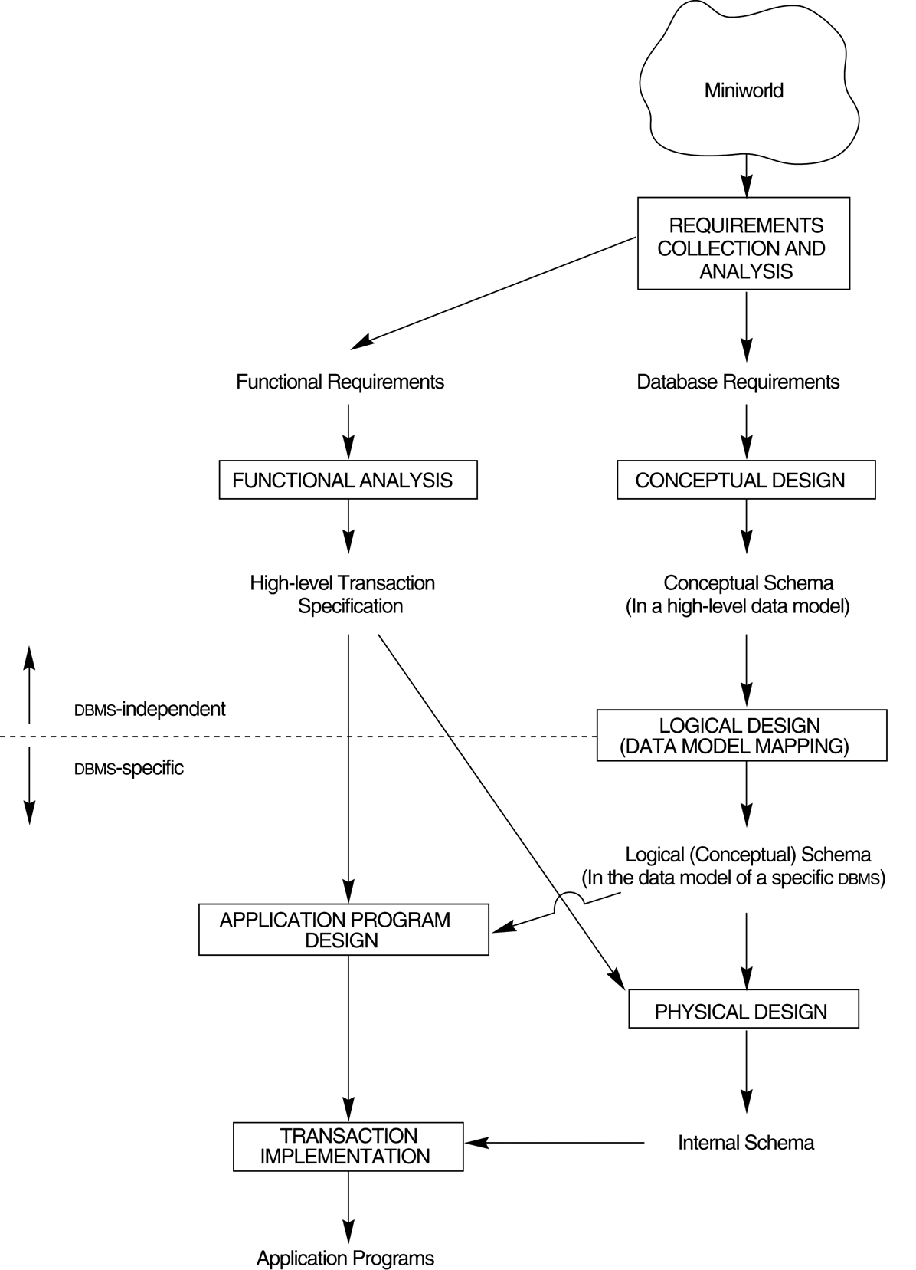
A simplified diagram to illustrate the main phases of database design.

Slide 3
Definitions
DATABASE
a collection of entities,
relationship among entities.
ENTITY
an object that exists and is distinguishable from other objects.
ATTRIBUTES
Example: people have names and addresses
ENTITY SET
Set of entities of the same type that share the same properties
Example: specific person, company, event, plant
Example: set of all persons, companies, trees, holidays

Slide 4
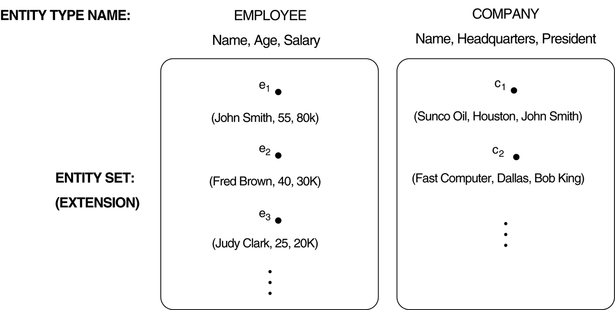
Two entity types, EMPLOYEE and COMPANY, and some member entities of each.

Slide 5
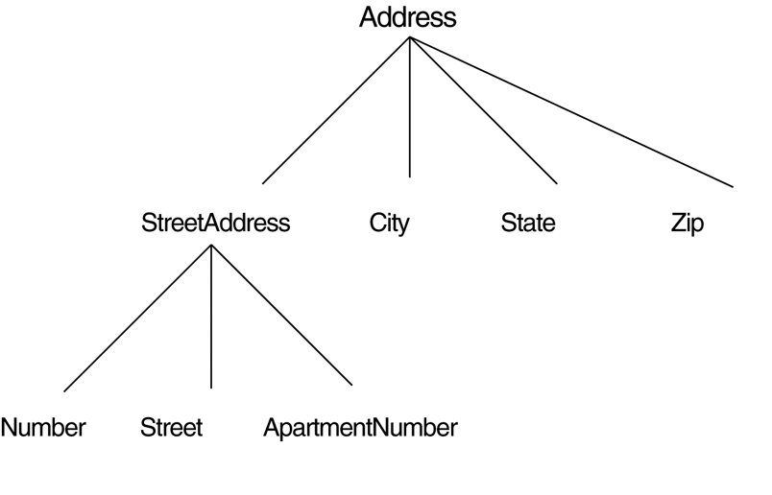
Attribute types:
Simple and composite attributes
Simple: Each entity has a single atomic value for the attribute. For example, Identity Number.
Composite attributes The attribute may be composed of several components. For ex,Address (Street Address, City, State, ZipCode )
Single-valued and multi-valued attributes
Single-valued:May have single value.For ex, Name of student
Multi-valued attributes :An entity may have multiple values for that attribute. For example, Color of a CAR or Denoted as {Color} or PreviousDegrees of a STUDENT. {PreviousDegrees}.
Derived attributes
Can be computed from other attributes E.g. age, given date of birth

Slide 6
Key Attributes
An attribute of an entity type for which each entity must have a unique value is called a key attribute of the entity type. For example, ID of EMPLOYEE.
A key attribute may be composite. For example, VehicleTagNumber is a key of the CAR entity type with components (Number, State).
An entity type may have more than one key. For example, the CAR entity type may have two keys:
VehicleIdentificationNumber (popularly called VIN)
VehicleTagNumber (Number, State), also known as license_plate number.

Slide 7
Weak Entity Types
An entity that does not have a key attribute
A weak entity must participate in an identifying relationship type with an owner or identifying entity type
Entities are identified by the combination of:
A partial key of the weak entity type
The particular entity they are related to in the identifying entity type
Example:
Suppose that a DEPENDENT entity is identified by the dependent’s first name and birhtdate, and the specific EMPLOYEE that the dependent is related to. DEPENDENT is a weak entity type with EMPLOYEE as its identifying entity type via the identifying relationship type DEPENDENT_OF

Slide 8
Notations

Slide 9
EMPLOYEE
Name, SSN, Sex, Address, Salary, Birthdate, Department,
Supervisor, {Works on ( Project, Hours)}
WORKS_FOR
N
1
Name SSN . . .
EMPLOYEE
DEPARTMENT
Relationship instances of WORKS_FOR:
{(KV, CS), (Pan, EE), . . .}
9

Slide 10
Relationship Sets
A relationship is an association among several entities Example: Hayes depositor A-102 customer entity relationship set account entity
A relationship set is a mathematical relation among n ≥ 2 entities, each taken from entity sets
{(e₁, e₂, … e_{n}) | e₁ ∈ E₁, e₂ ∈ E₂, …, e_{n} ∈ E_{n}} where (e₁, e₂, …, e_{n}) is a relationship
Example: (Hayes, A-102) ∈ depositor

Slide 11
Degree of a Relationship Set
Refers to number of entity sets that participate in a relationship set.
Relationship sets that involve two entity sets are binary (or degree two). Generally, most relationship sets in a database system are binary
Relationship sets may involve more than two entity sets. Relationship types of degree 3 are called ternary and of degree n are called n-ary.
Relationships between more than two entity sets are rare. Most relationships are binary.

Slide 12
Recursive relationship
Each entity type in a relationship type plays a particular role that is described by a role name. Role names are especially important in recursive relationship types where the same entity participates in more than one role:
Employee
Supervisor 1
N Supervisee
Supervision

Slide 13
Mapping Cardinality Constraints
Express the number of entities to which another entity can be associated via a relationship set.
Useful in describing binary relationship sets.
For a binary relationship set the mapping cardinality must be one of the following types:
One to one
One to many
Many to one
Many to many

Slide 14
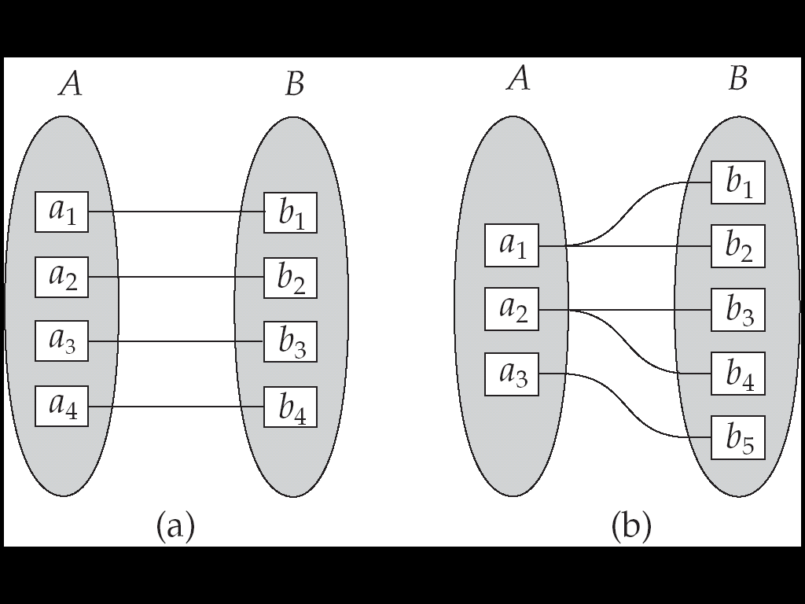
Mapping Cardinalities
One to one
One to many
Note: Some elements in A and B may not be mapped to any
elements in the other set

Slide 15
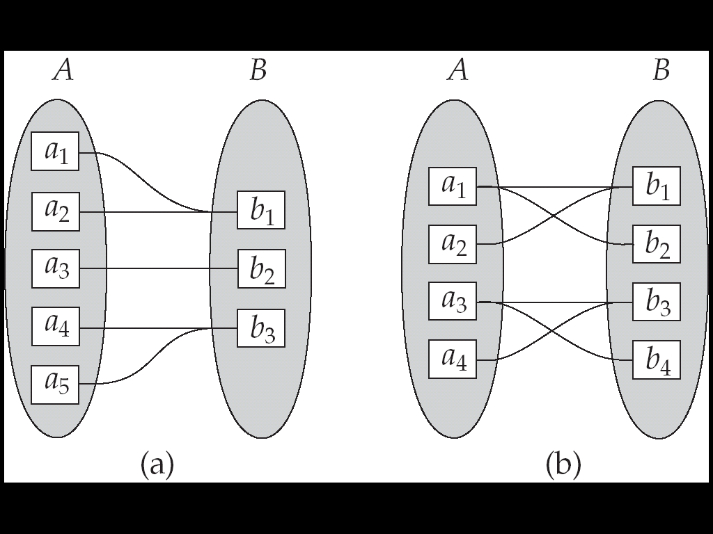
Mapping Cardinalities
Many to one
Many to many
Note: Some elements in A and B may not be mapped to any
elements in the other set

Slide 16
Many-to-one (N:1) RELATIONSHIP
EMPLOYEE
WORKS_FOR
DEPARTMENT
e_{1 }
e_{2 }
e_{3 }
e_{4 }
e_{5 }
e_{6 }
e_{7 }
r₁
r₂
r₃
r₄
r₅
r₆
r₇
● d₁
● d₂
● d₃

Slide 17
Many-to-many (M:N) RELATIONSHIP
e_{1 }
e_{2 }
e_{3 }
e_{4 }
e_{5 }
e_{6 }
e_{7 }
r₁
r₂
r₃
r₄
r₅
r₆
r₇
● p₁
● p₂
● p₃

Slide 18
Relationships and Relationship Types (3)
Recursive relationship type:
Both participations are same entity type in different roles.
For example, SUPERVISION relationships between EMPLOYEE (in role of supervisor or boss) and (another) EMPLOYEE (in role of subordinate or worker).
In following figure, first role participation labeled with 1 and second role participation labeled with 2.
In ER diagram, need to display role names to distinguish participations.

Slide 19
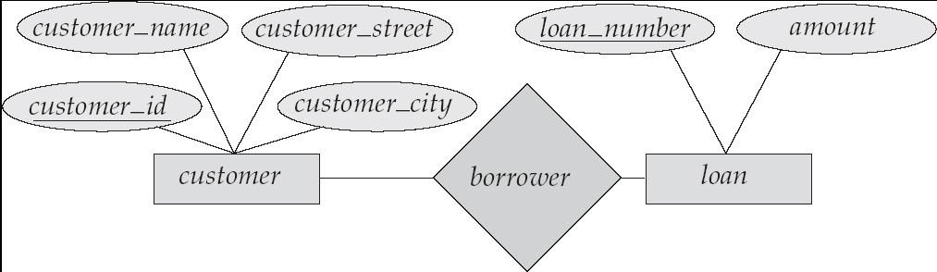
E-R Diagrams
Rectangles represent entity sets.
Diamonds represent relationship sets.
Lines link attributes to entity sets and entity sets to relationship sets.
Ellipses represent attributes
Double ellipses represent multivalued attributes.
Dashed ellipses denote derived attributes.
Underline indicates primary key attributes

Slide 20
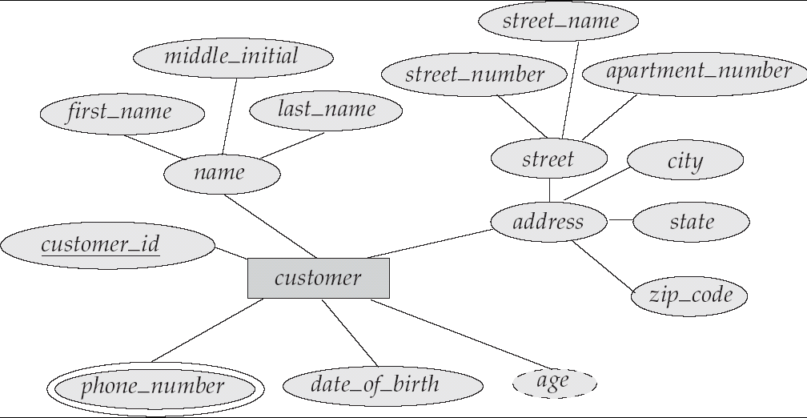
E-R Diagram With Composite, Multivalued, and Derived Attributes

Slide 21
Cardinality Constraints
We express cardinality constraints by drawing either a directed line (→), signifying “one,” or an undirected line (—), signifying “many,” between the relationship set and the entity set.
One-to-one relationship:
A customer is associated with at most one loan via the relationship borrower
A loan is associated with at most one customer via borrower

Slide 22
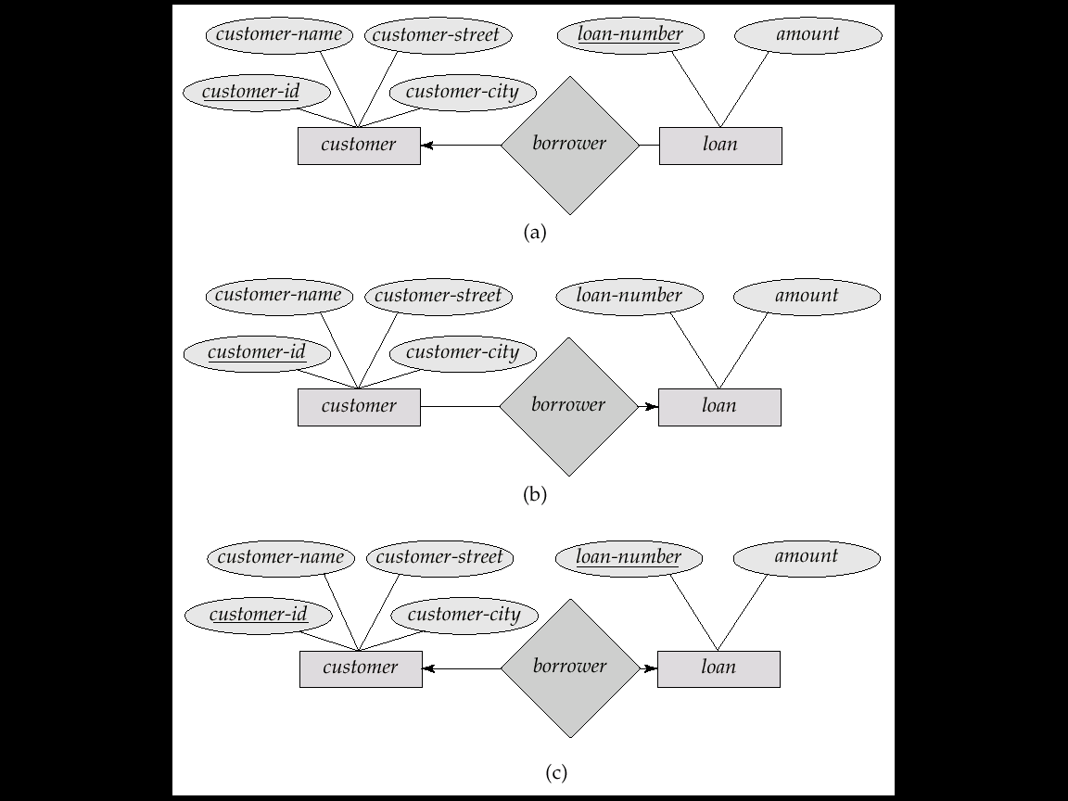
One-To-Many Relationship
In the one-to-many relationship a loan is associated with at most one customer via borrower, a customer is associated with several (including 0) loans via borrower

Slide 23
Many-To-One Relationships
In a many-to-one relationship a loan is associated with several (including 0) customers via borrower, a customer is associated with at most one loan via borrower

Slide 24
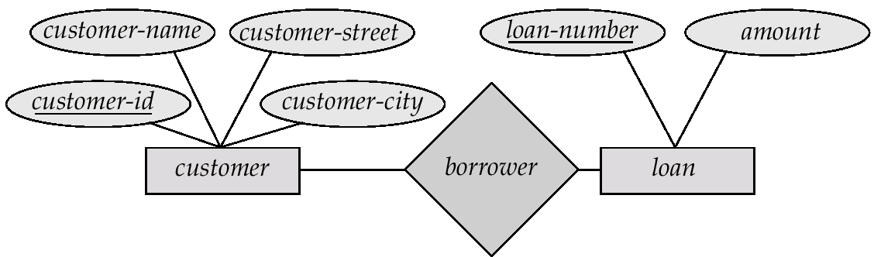
Many-To-Many Relationship
A customer is associated with several (possibly 0) loans via borrower
A loan is associated with several (possibly 0) customers via borrower

Slide 25
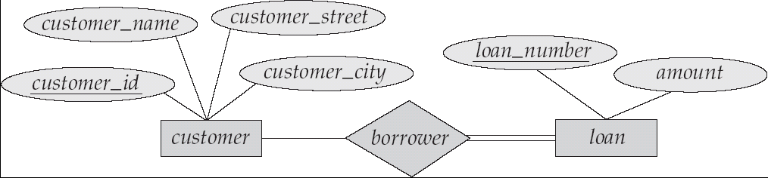
Participation of an Entity Set in a Relationship Set
Total participation (indicated by double line): every entity in the entity set participates in at least one relationship in the relationship set
E.g. participation of loan in borrower is total
every loan must have a customer associated to it via borrower
Partial participation: some entities may not participate in any relationship in the relationship set
Example: participation of customer in borrower is partial

Slide 26
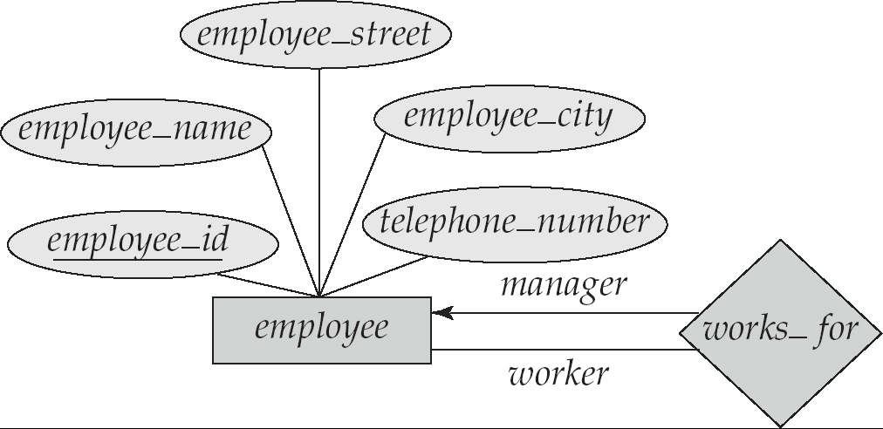
Roles
Role labels are optional, and are used to clarify semantics of the relationship

Slide 27
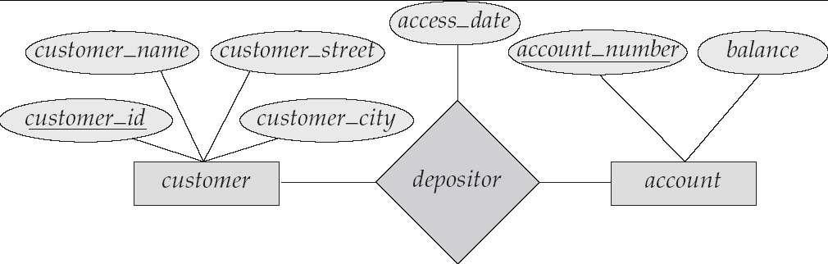
Relationship Sets with Attributes

Slide 28
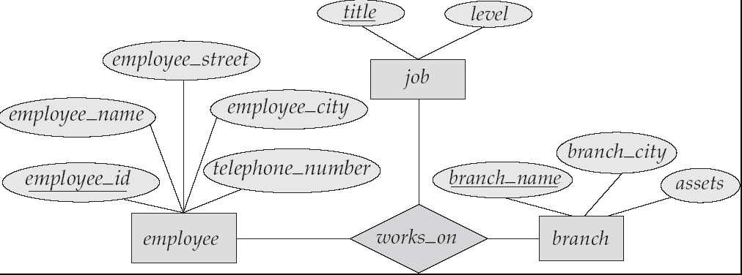
E-R Diagram with a Ternary Relationship

Slide 29
Entities are:
EMPLOYEE
DEPARTMENT
PROJECT
DEPENDENT

Slide 30
ER DIAGRAM –
Relationship Types are:
WORKS_FOR,
MANAGES,
WORKS_ON,
CONTROLS,
SUPERVISION,
DEPENDENTS_OF

Slide 31
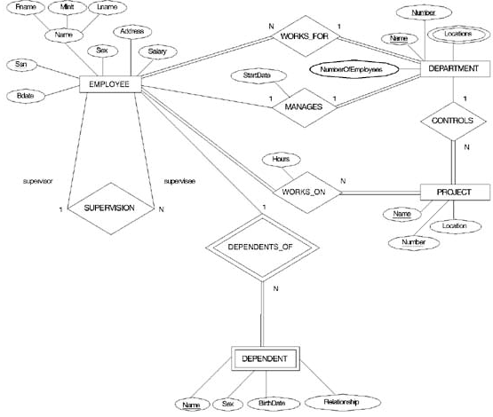
ER DIAGRAM – Entity Types are: EMPLOYEE, DEPARTMENT, PROJECT, DEPENDENT

Slide 32
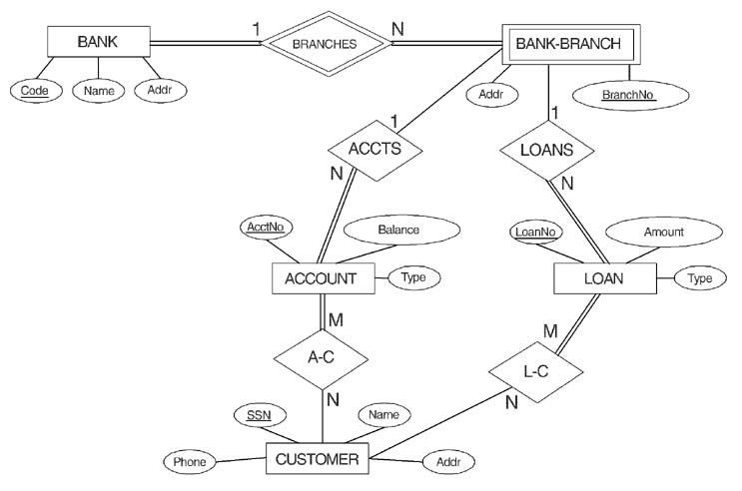
ER DIAGRAM FOR A BANK DATABASE

Slide 33
PROBLEM with ER notation
THE ENTITY RELATIONSHIP MODEL IN ITS ORIGINAL FORM DID NOT SUPPORT THE SPECIALIZATION/ GENERALIZATION ABSTRACTIONS

Slide 34
Thankyou

